Slide 1
Wound care
Dr. Ashwini Kale
Dept. Of Neurophysiotherapy
MGM Institute Of Physiotherapy
Chh. Sambhajinagar

Slide 2
Injury to vascularized tissue results in a coordinated, complex, and dynamic series of events collectively referred to as inflammation and repair
The sequelae depend on the source and site of injury, the state of local homeostasis, and whether the injury is acute or chronic.
The ultimate goal of inflammation and repair is to restore function by eliminating the pathological or physical insult, replacing the damaged or destroyed tissue, and promoting regeneration of normal tissue structure.

Slide 4
THE PHASES OF INFLAMMATION AND HEALING
INFLAMMATION PHASE (DAYS 1 TO 6)

Slide 5
This immediate protective response attempts to destroy, dilute, or isolate the cells or agents that may be at fault.
It is a normal and necessary prerequisite to healing.
Inflammation can also be harmful, particularly when it is directed at the wrong tissue or is overly exuberant.
For example, inappropriately directed inflammatory reactions that underlie autoimmune diseases

Slide 7
Hyperemia
Inc temperature
Redness
Inc permeability

Slide 8
Pain pressure of swelling nerve irritation chemical

Slide 10
The inflammatory phase involves a complex sequence of interactive and overlapping events, including vascular, cellular, hemostatic, and immune processes.
Humoral and neural mediators act to control the inflammatory phase.
Evidence indicates that immediately after injury, platelets and neutrophils predominate and release a number of factors that amplify the platelet aggregation response, initiate a coagulation cascade, or act as chemo attractants for cells involved in the inflammatory phase.
Neutrophil infiltration ceases after a few days, and neutrophils are replaced by macrophages starting 2 days after injury.
This shift in cell type at the site of injury correlates with a shift from the inflammation phase to the proliferation phase of healing

Slide 11
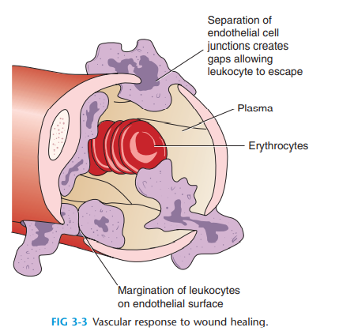

Slide 14
Vascular response
extravasation
Margination
Pavementing
Diapedesis
Emmigration

Slide 16
Transudate – start – less cells and less proteins
Exudate – end - more
Suppurative exudate - pus

Slide 17
Four mechanism involved-
first mechanism is endothelial cell contraction, which leads to widening of intercellular junctions or gaps. This mechanism affects venules while sparing capillaries and arterioles. It is controlled by chemical mediators and is relatively short-lived, lasting for only 15 to 30 minutes.
The second mechanism is a result of direct endothelial injury and is an immediate, sustained response that potentially affects all levels of the microcirculation. This effect is often seen in severe burns or lytic bacterial infections and is associated with platelet adhesion and thrombosis or clot formation.
Leukocyte dependent endothelial injury is the third mechanism. Leukocytes bind to the area of injury and release various chemicals and enzymes that damage the endothelium, thus increasing permeability.
The final mechanism is leakage by regenerating capillaries that lack a differentiated endothelium and therefore do not have tight gaps. This may account for the edema characteristic of later healing inflammation

Slide 19
Hemostatic response
Controls blood loss
After injury platelets enter the area and bind to the exposed collagen, releasing fibrin to stimulate clotting. Platelets also release a regulatory protein known as platelet derived growth factor (PDGF), which is chemotactic and mitogenic to fibroblasts and may also be chemotactic to macrophages, monocytes, and neutrophils
Cellular response
Immune rsponse

Slide 20
Cellular response –
RBC – blood supply ,
Leucocyte – clearing debris
Neutrophils, macrophages– phagocytosis
basophils- release histamine to increase vascular permeability
Immune response-

Slide 22
PROLIFERATION PHASE (DAYS 3 TO 20)
epithelial cells and connective tissues.

Slide 23
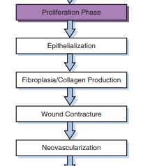

Slide 24
Epithelialization, the reestablishment of the epidermis, is initiated early in proliferation when a wound is superficial, often within a few hours of injury.
Epithelialization provides a protective barrier to prevent fluid and electrolyte loss and to decrease the risk of infection.
Healing of the wound surface by epithelialization alone does not provide adequate strength to meet the mechanical demands placed on most tissues.
Such strength is provided by collagen produced during fibroplasia

Slide 25
During epithelialization, uninjured epithelial cells from the margins of the injured area reproduce and migrate over the injured area, covering the surface of the wound and closing the defect.
It is hypothesized that the stimulus for this activity is the loss of contact inhibition that occurs when epithelial cells are normally in contact with one another.
Migrating epithelial cells stay connected to their parent cells, thereby pulling the intact epidermis over the wound edge.
When epithelial cells from one edge meet migrating cells from the other edge, they stop moving because of contact inhibition

Slide 27
Collagen Production
Fibroblasts make collagen. Fibroblast growth, known as fibroplasia, takes place in connective tissue.
Fibroblasts develop from undifferentiated mesenchymal cells located around blood vessels and in fat.
They migrate to the injured area and align perpendicular to cappilaries.
Wound contraction
Neovascularization

Slide 31
MATURATION PHASE (DAY 9 FORWARD) - longestttttttt
It can persist longer than a year after the initial insult.
During this time, the numbers of fibroblasts, macrophages, myofibroblasts, and capillaries decrease, and the water content of the tissue declines.
The scar becomes whiter in appearance as collagen matures and vascularity decreases.
The ultimate goal of this phase is restoration of the prior function of injured tissue.
Several factors determine the rate of maturation and the final physical characteristics of the scar.
These include fiber orientation and the balance of collagen synthesis and lysis in balanced fashion.

Slide 32
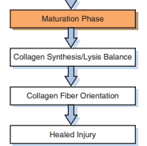

Slide 33
Chronic

Slide 34
Factors affecting healing
Local- type , size, location, infection , vascular supply
External - movement
Systematic- age, disease, medication, nutrition

Slide 35
scale
Bates- Jenson wound assessment tool
BWAT.pdf

Slide 36
Current for healing

Slide 38
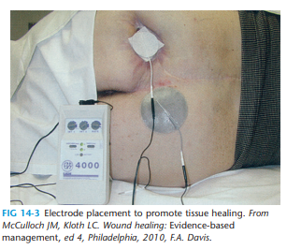
current

Slide 39
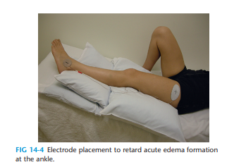

Slide 40
laser

Slide 41
US

Slide 43
UVR
UV is used occasionally as a component of the treatment of chronic wounds.
When UV is used for wound treatment, UVC is the frequency band most commonly chosen because it may contribute to wound healing while causing little erythema or tanning. UVC also has a low carcinogenic effect and is absorbed almost equally by all skin colors.
UV radiation is thought to facilitate wound healing by increasing epithelial cell turnover, causing epidermal cell hyperplasia, accelerating granulation tissue formation, increasing blood flow, killing bacteria, increasing vitamin D production by the skin, and promoting sloughing of necrotic tissue.
LESS EVIDANT

